Slide 1
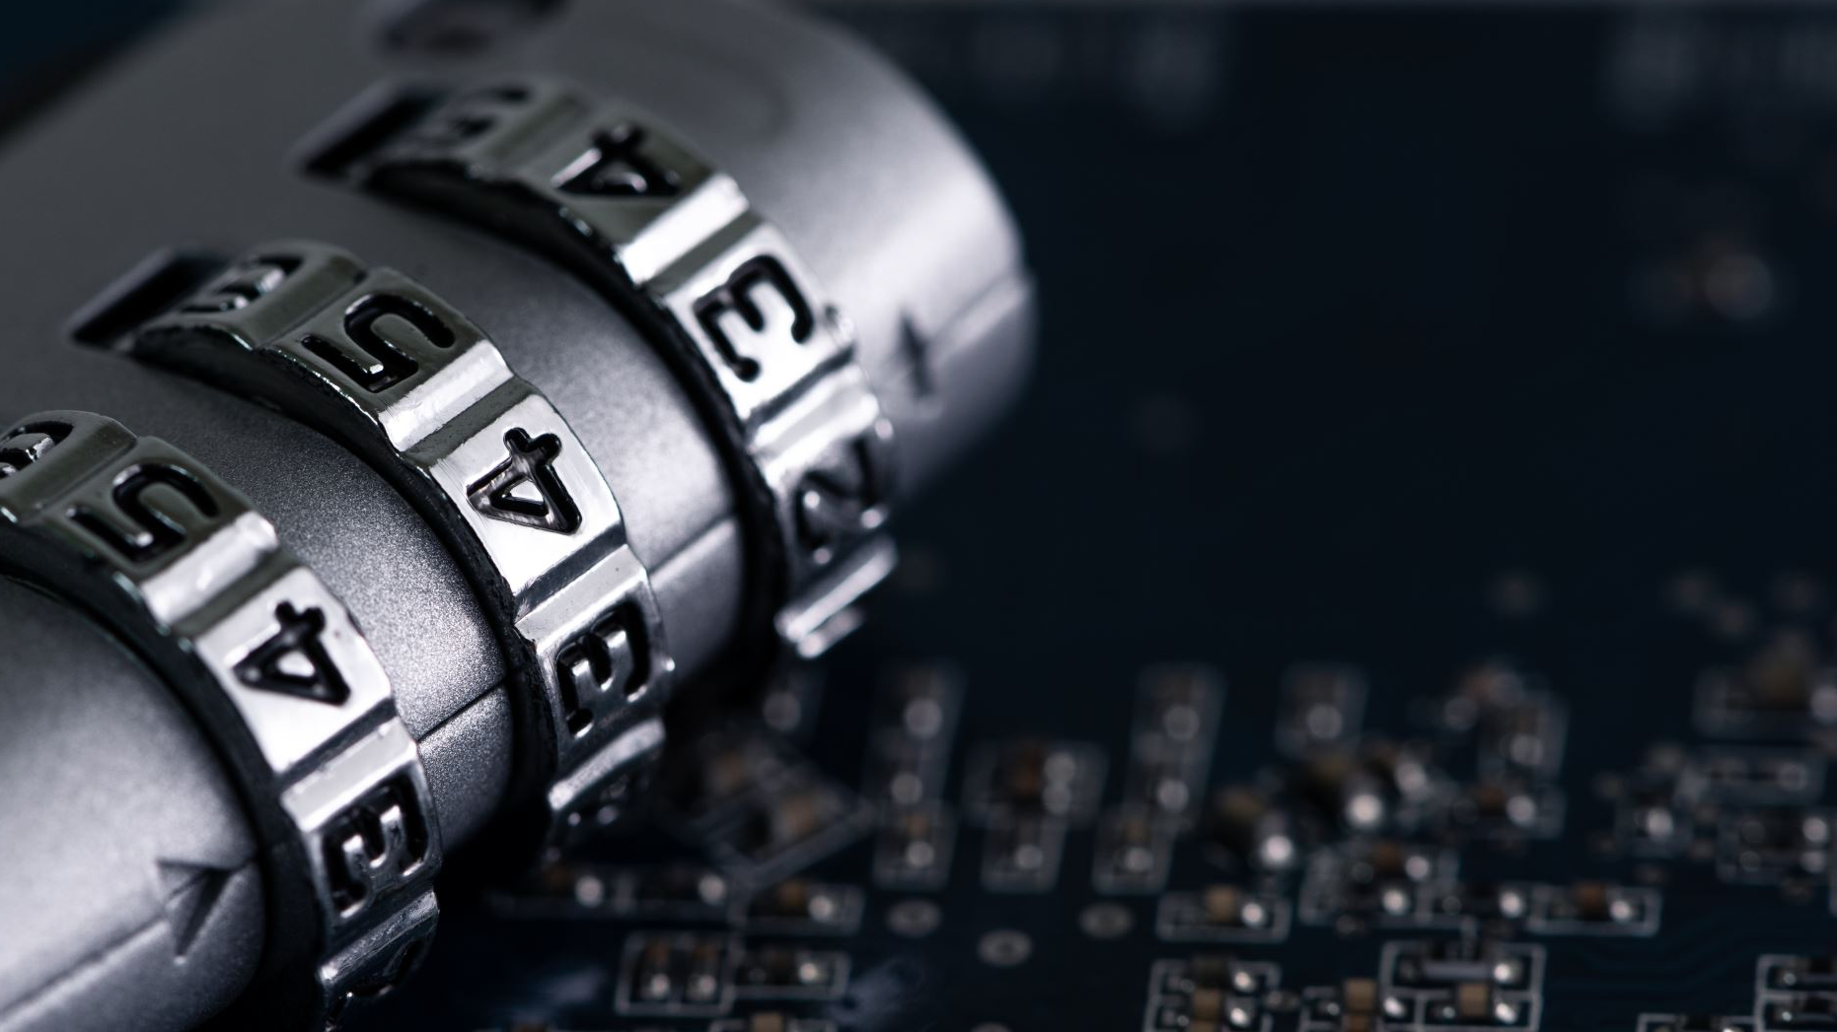
Privacy & Security
Learning Outcome 3

Slide 2
Learning Objectives
Describe what privacy is
Understand what privacy regulations exist
Understand privacy in the context of the digital world
Describe what security is
Understand security in the context of the digital world
Understand the implications of a security breach

Slide 3
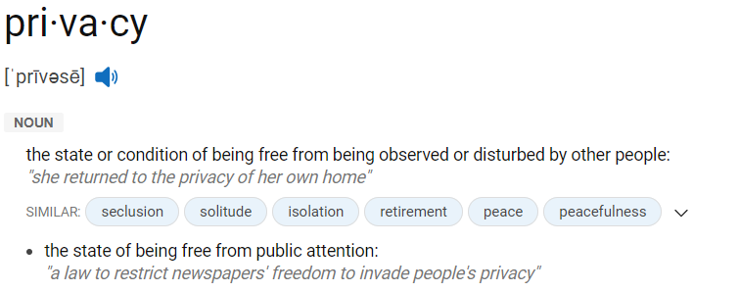
Privacy
Notes:
Privacy enables us to create boundaries and protect ourselves from unwarranted interference in our lives, allowing us to negotiate who we are and how we want to interact with the world around us.
Privacy protects us from arbitrary and unjustified use of power by states, companies and other actors. It lets us regulate what can be known about us and done to us, while protecting us from others who may wish to exert control.

Slide 4
Privacy
Show of hands:
Is privacy a Human Right?
Notes:
Take a count of: YES/NO/NOT SURE

Slide 5
Privacy
Privacy IS a Human Right
Right to privacy is articulated in all the major international and regional human rights governing bodies
Over 130 countries have constitutional statements regarding the protection of privacy
Over 100 countries have some form of personal data protection law
Despite international human rights law, it’s all too common that privacy is violated by states and companies.

Slide 6
Privacy
Privacy IS a Human Right
The idea of the “Right to be Forgotten”
The right to erasure – General Data Protection Regulation (GDPR)
Only applies to certain circumstances

Slide 7


Slide 8
Privacy
Why does it matter now?
Split into teams of ~5 and take 15 minutes to come with at least 3 reasons why privacy matters right here and now
Write down your answers and choose a speaker to present

Slide 9
Privacy
Why does it matter now?
Advancements in processing personal data
Fast-expanding global surveillance industry is leading mass surveillance
“Fight against terrorism”
State surveillance
Mass interception of communications
Indiscriminate data retention policies
Locational surveillance
CCTV, Ring cameras, etc…
Notes:
Advancements in processing personal data (including the ever-increasing power to intercept, access, collect, store and analyse data; centralised DNA and biometric databases; and more sophisticated algorithms able to de-anonymise data) are outpacing existing, out-of-date legal protections. Meanwhile, the emergence of a fast-expanding global surveillance industry is enabling government agencies to interfere with the right to privacy, including by conducting mass surveillance.
Technological developments are coupled with a global discourse on security and counter- terrorism that treats the privacy of individuals as an impediment to the “fight against terrorism”, wrongly pitching privacy against security. This discourse has led to the adoption of laws that grant intelligence services extended powers, with little oversight.
State surveillance and misuse of personal data take many forms: mass interception of communications; indiscriminate data retention policies; locational surveillance, via CCTV, GPS and similar technology; mandatory registration of SIM cards, compulsory IDs, and biometric systems. Hacking, malware and other means of compromising the security of communication systems are likewise pursued with increasing success by security and intelligence agencies.
Increasingly, we’re not being informed about the monitoring we’re placed under; the way our personal data are collected, analysed and shared; nor given the opportunity to question these activities. In fact, civil society organisations sometimes face threats when researching state policies and practices or documenting violations of the right to privacy.

Slide 10
Data Privacy in 2021
84% of people care about their digital privacy & 80% are willing to take action to protect it.
79% of people are “Very Concerned” about how companies are handling their personal privacy.
81% of people feel they have little to no control on their data.
How many people read the consent documents?!
https://www.ioscm.com/blog/privacy-in-the-digital-age-whats-at-stake-and-how-to-protect-yourself/

Slide 11
Company Promises
Apple, popup window asking for consent for tracking.
Google, Disable tracking technologies in Chrome.
Facebook, Show ads without relying on personal data.
What is the impact on businesses depending on Facebook ads?!

Slide 12
Privacy
Due to increased personal, business, & state surveillance, privacy is no longer achievable in our modern, digitally connected world
Split into 2 teams and take a side, agree or disagree
Take 20 minutes to build your arguments
Debate the validity of the above statement

Slide 13


Slide 14
Privacy Issues
Identity Theft
Ownership of Information and Consent
Freedom to be (L, L, PoH)
Surveillance

Slide 15
How to Protect Digital Privacy
Read the terms and conditions
Limit the information you share
Opt-out of data brokers
Engage in conversation
Lobby elected officials

Slide 16
Privacy
The government of Canada and Saskatchewan have laws that support and enforce your right to privacy:
The Privacy Act (Federal – “The Act”)
The Personal Information Protection and Electronic Documents Act (Federal – “PIPEDA”)
The Health Information Protection Act (Provincial – “HIPA”)

Slide 17
Privacy
Canadian Laws and Standards:
The Privacy Act:
The Privacy Act relates to a person’s right to access and correct personal information that the Government of Canada holds about them. The Act also applies to the Government’s collection, use and disclosure of personal information while providing services such as:
Old age security pensions (CPP)
Employment insurance (EI)
Border security (CBSA)
Federal policing and public safety (RCMP, CSIS)
Tax collection and refunds (CRA)

Slide 18
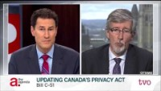
2016

Slide 19
Group Discussion
Is the Privacy Act enough?
Yes or No? Why?

Slide 20
PIPEDA, The Personal Information Protection and Electronic Documents Act
PIPEDA
PIPEDA was developed in 1995 and became law on April 13, 2000
It went into effect on Jan 1st, 2001
It went fully into force on Jan 1st, 2004
Last revision was May 2019
Introduced to ensure trust between the individual & the way companies use their data
https://www.priv.gc.ca/en/privacy-topics/privacy-laws-in-canada/the-personal-information-protection-and-electronic-documents-act-pipeda/pipeda_brief/

Slide 21
PIPEDA
Organizations covered by PIPEDA must generally obtain one’s consent when they collect, use or disclose that individual's personal information.
People have the right to access their personal information held by an organization.
People have the right to challenge its accuracy.
Personal information can only be used for the purposes for which it was collected.
Personal information must be protected by appropriate safeguards.

Slide 22
How PIPEDA Applies?
It applies to private sector organizations across Canada.
It regulates the collection, use, or disclosure of personal information over the course of A COMMERCIAL ACTIVITY
Alberta, British Columbia and Quebec have their own private-sector privacy laws that have been deemed substantially similar to PIPEDA.

Slide 23
PIPEDA, Information that crosses borders
All businesses that operate in Canada and handle personal information that crosses provincial or national borders during routine commercial activities are subject to PIPEDA, regardless of the province or territory in which they are based
This includes said provinces with substantially similar legislation

Slide 24
PIPEDA Federally Regulated Organizations
Airports, aircraft and airlines
Banks and authorized foreign banks
Interprovincial or international transportation companies
Telecommunications companies
Offshore drilling operations
Radio and television broadcasters

Slide 25
What is Personal Information?
Age, name, ID numbers, income, ethnic origin, or blood type
Opinions, evaluations, comments, social status, or disciplinary actions
Employee files, credit records, loan records, medical records, existence of a dispute between a consumer and a merchant, intentions
Ex. to acquire goods or services, or change jobs
?
Is That Enough?

Slide 26
Not in scope of PIPEDA
Personal information handled by federal government organizations listed under The Act
Provincial or territorial governments and their agents
Business contact information: an employee’s name, title, business address, telephone number or email addresses that is collected, used or disclosed solely for the purpose of communicating with that person in relation to their employment or profession
An individual's collection, use or disclosure of personal information strictly for personal purposes
Ex. A personal greeting card list
An organization's collection, use or disclosure of personal information solely for journalistic, artistic or literary purposes

Slide 27
PIPEDA
PIPEDA fair information 10 principles:
Accountability
Identifying purposes
Consent
Limiting collection of information
Limiting use, disclosure and retention of information
Accuracy
Safeguards
Openness
Individual access
Challenging compliance

Slide 28
PIPEDA Fair Information Principles
Accountability
Comply with all 10 fair information principles.
Appoint someone to be responsible for your organization’s PIPEDA compliance.
Protect all personal information held by your organization, including any personal information you transfer to a third party for processing.
Develop and implement personal information policies and practices.
What personal information do we collect and is it sensitive?
Why do we collect it?
How do we collect it?
What do we use it for?
Where do we keep it?
How is it secured?
Who has access to or uses it?
Who do we share it with?
When is it disposed of?

Slide 29
PIPEDA Principles
2. Identify Purpose
Identify and document your purposes for collecting personal information.
Tell your customers why your organization needs their personal information before or at the time of collection.
Obtain their consent again should you identify a new purpose.
3. Consent
Organizations are generally required to obtain meaningful consent for the collection, use and disclosure of personal information.
The form of consent must take into account the sensitivity of the personal information.
Individuals can withdraw consent at any time

Slide 30
PIPEDA Principles
4. Limiting Collection
Collect only the personal information your organization needs to fulfill a legitimate identified purpose.
Be honest about the reasons you are collecting personal information.
Collect personal information by fair and lawful means.
5. Limiting Use, Disclosure, and Retention
Unless someone consents otherwise—or unless doing so is required by law—your organization may use or disclose personal information only for the identified purposes for which it was collected.
Put guidelines and procedures in place for retaining and destroying personal information.

Slide 31
PIPEDA Principles
6. Accuracy
Minimize the possibility of using incorrect information when making a decision about an individual or when disclosing information to third parties.
7. Safeguards
Protect personal information in a way that is appropriate to how sensitive it is.
Protect all personal information (regardless of how it is stored) against loss, theft, or any unauthorized access, disclosure, copying, use or modification.
NOTE: PIPEDA does not specify particular security safeguards that must be used. Your organization must continually ensure it adequately protects the personal information in its care as technologies evolve and as new risks emerge.

Slide 32
PIPEDA Principles
8. Openness
Consumers find privacy policies are difficult to understand, yet they feel compelled to give their consent in order to obtain the goods and services they want.
Inform your customers and employees that you have policies and practices for managing personal information.
9. Individual Access
When asked, advise people about the personal information about them your organization holds.
Explain how that information is or has been used and to whom it has been disclosed.
Give people access to their information at minimal or no cost, or explain your reasons for not providing access.

Slide 33
PIPEDA Principles
10. Challenging Compliance
An individual must be able to challenge your organization’s compliance with the fair information principles. They should address their challenge to the person in your organization who is accountable for compliance with PIPEDA.
Provide recourse by developing simple complaint handling and investigation procedures.
Tell complainants about their avenues of recourse. These include your organization’s own complaint procedures, along with those related to industry associations, regulatory bodies and the OPC.
Investigate all complaints you receive.
Improve any information-handling practices and policies that are found to be problematic.

Slide 34
Clearview AI Case
Take 10 minutes to read the case individually.
Discuss it together and answer the following questions:
Which PEPIDA principles did Clearview AI violate?

Slide 35
Consumer Privacy Protection Act (CPPA)
The Digital Charter Implementation Act (Bill C-11).
Repeal “parts” of PIPEDA.
Under CPPA, the Privacy Commissioner may:
Request the production of records.
Enter private places to examine records.
Share relevant information with federal regulatory bodies.
Share information with provincial authorities and foreign states.

Slide 36
PEPIDA and CPPA
Individuals can sue companies for violations.
Stronger consent requirements.
More detailed explanation on the data collection, purpose, and use.
No further restriction added on transferring data outside of Canada.
Individuals can make requests to have their data deleted as soon as it is reasonably feasible.

Slide 37
PEPIDA and CPPA, Powers of Enforcement
Companies will have to perform privacy assessment in circumstances other than after a breach.
Notifications must be done as soon as it is feasible after a breach. (EU GDPR states 72 hours)
Additional record keeping about breaches.

Slide 38
PEPIDA and CPPA, Powers of Enforcement
Fines are more in line with other international privacy laws.
PIPEDA
CPPA
CPPA, Severe
Maximum fine
CA $100,000
Maximum fine is
CA $10,000,000
Or
3% of “Global” annual revenue
Maximum fine is
CA $25,000,000
Or
5% of “Global” annual revenue

Slide 39
CPPA, New Exceptions
Organizations may transfer an individual’s personal information to a service provider without consent if necessary for delivery of a product or service that the individual has requested.
Organizations may use an individual’s personal information to de-identify the information (Data Anonymization).
Organizations may use an individual’s personal information for internal research and/or development as long as it is de-identified.
Organizations may disclose an individual’s personal information to any government, healthcare, post-secondary educational institution, or library, provided that the information is first de-identified

Slide 40
CPPA, Are These Violations?
A car dealership company collects information about customers who test drive their cars without notifying them.
A grocery store chain collected information about customers participating in a customer loyalty program. It was clear that the personal data was in exchange for the loyalty points.
A mass media and entertainment company did not allow customers to opt-out of the use of their personal data.
Online dating apps did not state that they will sell data including PII to 3rd parties.

Slide 41
What if Facebook violates CPPA?!
https://www.statista.com/statistics/268604/annual-revenue-of-facebook/

Slide 42
Privacy
The Health Information Protection Act (HIPA)
Patients have the right to access records containing their personal health information held by trustees.
It establishes rules for the collection, use and disclosure of health information by trustees and their colleagues.
Trustees are responsible for the information accessed, collected, used and disclosed by their employees, service suppliers and affiliated organizations.

Slide 43
Security

Slide 44
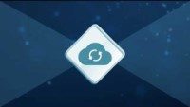

Slide 45
What Companies Lose?
What would companies lose in the case of a security breach?

Slide 46
Categories of Financial Loss
Detection – costs resulting from identifying and reporting a cyber attack as well as the expenses arising from audits, investigation, and mitigation.
Notification – costs associated with informing customers and stakeholders of a cyber attack.
Response – expenses that arises from the company’s response to an attack, including beefing up computer security, additional monitoring of computer systems, and providing affected customers with legal advice, credit monitoring services, and even discounts.
Business losses – cyber crimes often interrupt business operations, resulting in significant expenses. Lost revenue is only one of many potential effects of a data breach.

Slide 47
Security
Data Security is clearly a big deal for companies
Loss of revenue
Loss of market position
Law suits
Insolvency/bankruptcy
Despite this: companies are still plagued by privacy and security breaches

Slide 48
Security
2019 - MS Office 365, Box, Largest Data Breach ever discovered (87GB of unique emails and passwords)
2018 - Quora, Marriott International, FIFA, Cathay Pacific, Facebook, Uber, British Airways, Reddit, Under Armour, FedEx… and this list goes on….

Slide 49


Slide 50
Top 10 breaches in 2021
We will discuss the top 10 breaches of 2021.
Please take notes on how the data breach happened.
We will discuss this at the end of our class.

Slide 51
Top 10 breaches in 2021
Windows, May
38 Million.
PII data.
Open Data Protocols (OData) API for an organization’s Power Apps portal that contained an anonymously accessible list of data.
Android, May
100+ Million.
PII was accessible over 23 applications.
The findings showed the lack of basic security practices in many applications.
Thailand Visitors, Aug
106+ Million.
PII was unprotected!!
Thai authorities acknowledged the incident and secured the data the following day.
Raychat
150 Million.
Iranian business and social messaging application.
When misconfigured, the database can leave millions of documents vulnerable

Slide 52
Top 10 breaches in 2021
Socialarks
214+ Million.
11,651,162 Instagram user profiles
66,117,839 LinkedIn user profiles
81,551,567 Facebook user profiles
A further 55,300,000 Facebook profiles were summarily deleted within a few hours after security team first discovered the server and its vulnerability.
Brazilian Database, Jan
223 Million.
The databases included names, unique tax identifiers, facial images, addresses, phone numbers, email, credit score, salary and more.
The data was offered for free on a Darknet forum.
Bykea
400 Million.
Transportation, Pakistan
Researchers discovered Bykea publicly exposed all its production server information without password protection or encryption and allowed access to more than 200GB of data containing more than 400 million records.

Slide 53
Top 10 breaches in 2021
Facebook
553 Million. (106 Countries)
“A database of that size containing the private information such as phone numbers of a lot of Facebook's users would certainly lead to bad actors taking advantage of the data to perform social-engineering attacks [or] hacking attempts.”
LinkedIn
700 Million (93% of all members)
PII Was on sale online.
LinkedIn denied that there was a data breach. “a threat actor pulling data that was publicly available on a large scale.”
Cognyte
5,000,000,000
A cybersecurity analytics firm that stored the data as part of its cyber intelligence service
Data was exposed for 4 days!

Slide 54
Security
So if a security breach for a company is a “question of when, not if”….
How do we deal with it?
Any ideas?
Notes:
Should we cover it up? Should we tell the truth - how much of the truth should we tell?
Next slides are a survey of how the pros handle it

Slide 55
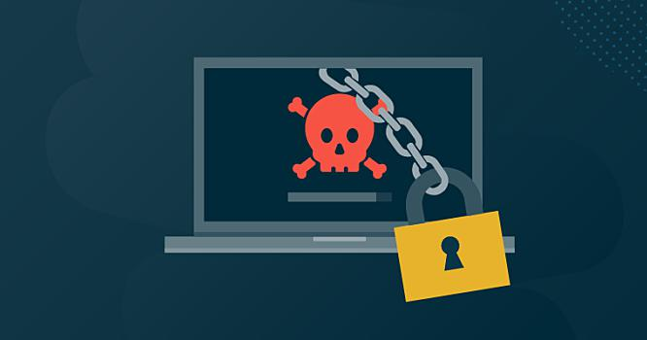
Cyber Attacks
Malware: spyware, viruses, ransomware, trojans, and worms.
Phishing:
Spear Phishing—targeted attacks directed at specific companies and/or individuals.
Whaling—attacks targeting senior executives and stakeholders within an organization.
Pharming—leverages DNS (Domain Name System) cache poisoning to capture user credentials through a fake login landing page.
Man-In-The-Middle (MitM) attacks.

Slide 56
Cyber Attacks
Distributed Denial of Service (DDoS) attacks.
SQL Injections.
Zero-Day Exploit: Zero-day attackers jump at the disclosed vulnerability in the small window of time where no solution/preventative measures exist.
Password Attack. (Social Engineering)
Cross-site Scripting.
Rootkits: rootkits hide in legitimate software
IoT Attacks: In one IoT attack case, a Vegas casino was attacked and the hacker gained entry via an internet-connected thermometer inside one of the casino’s fishtanks.

Slide 57
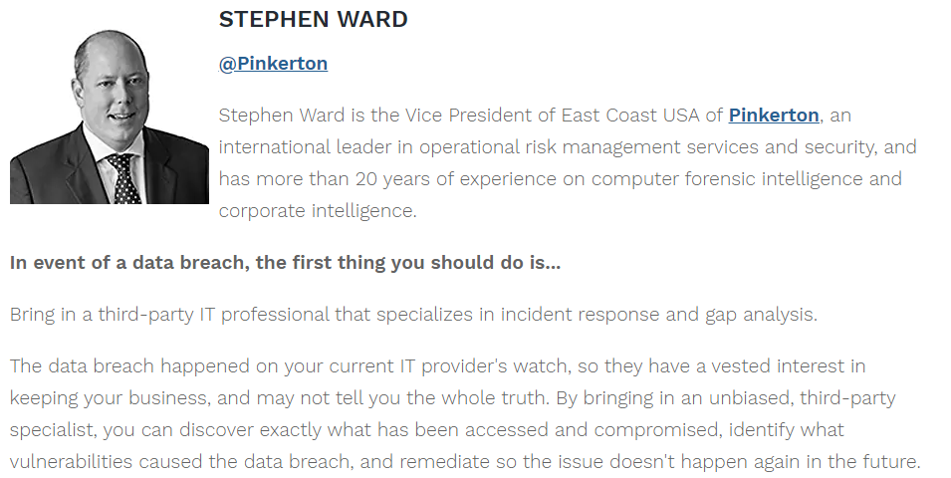
Security

Slide 58
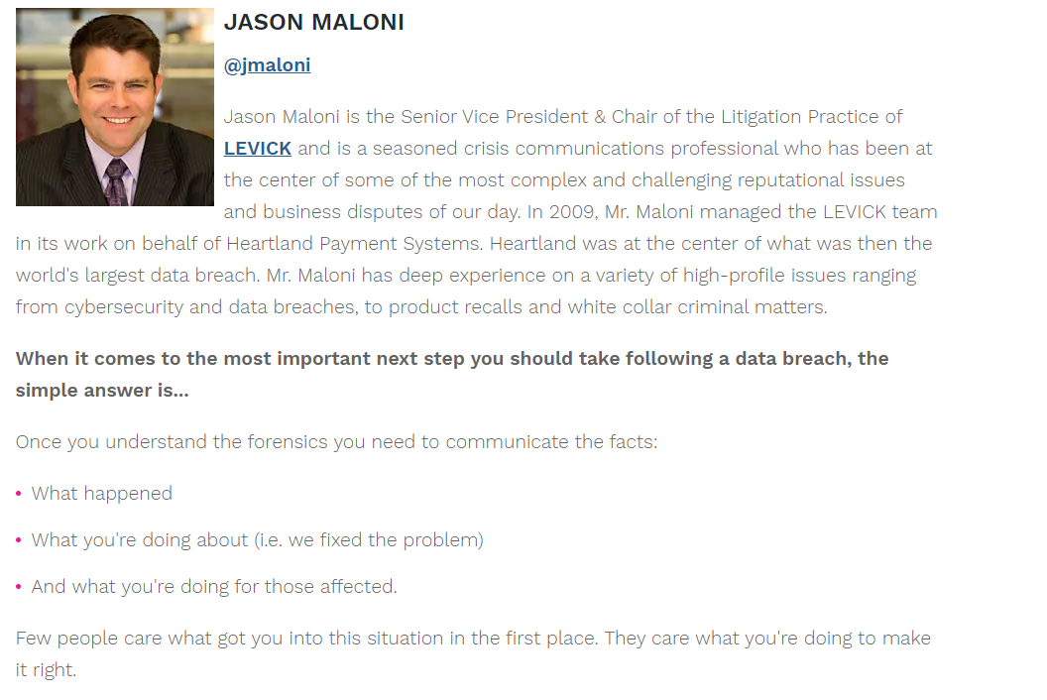
Security

Slide 59
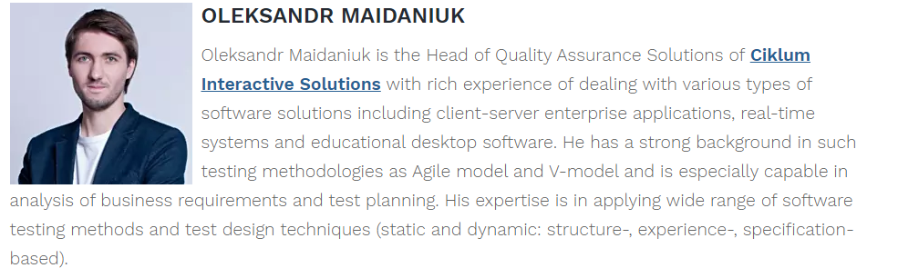
Security

Slide 60
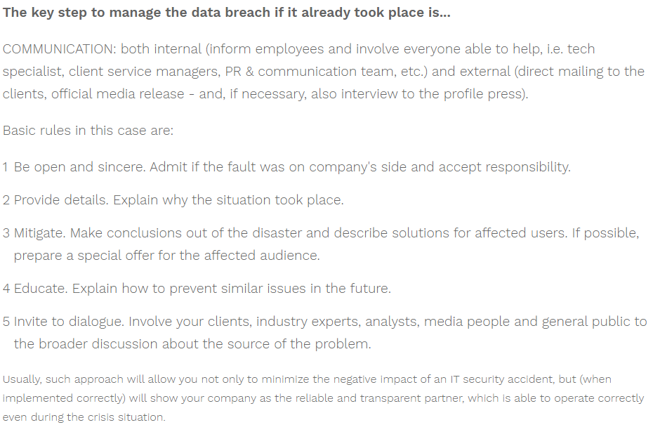
Security

Slide 61
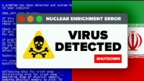
Security
Notes:
Foreshadow the inevitability thesis - was this a good thing to do - not just implications for businesses but also soverign nations
Likely the US and/or Israel

Slide 62
Security
So what can we do to make our personal digital lives more secure?
Any ideas?

Slide 63
Security
1. Change Your Passwords
https://haveibeenpwned.com/
2. Use a Password Manager
3. Delete Any Unused Accounts
4. Enable Two-Factor Authentication
5. Keep Your Software Up to Date
6. Training to Identify Phishing and Spear Phishing Attacks
Notes:
Explain each one and then ask who uses each

Slide 64
Service Organization Control 2 (SOC2)
Reports on various organizational controls related to security, availability, processing integrity, confidentiality or privacy.
The standard for regulating these five issues was formed under the American Institute of Certified Public Accountants (AICPA) Trust Services Principles and Criteria.
Notes:
Defines criteria for managing customer data based on 5 “trust service principles” - security, availability, processing integrity, confidentiality and privacy

Slide 65
SOC2

